Slide 1

Final Assessment
EXCEL
S.DIVYASHISH

Slide 2
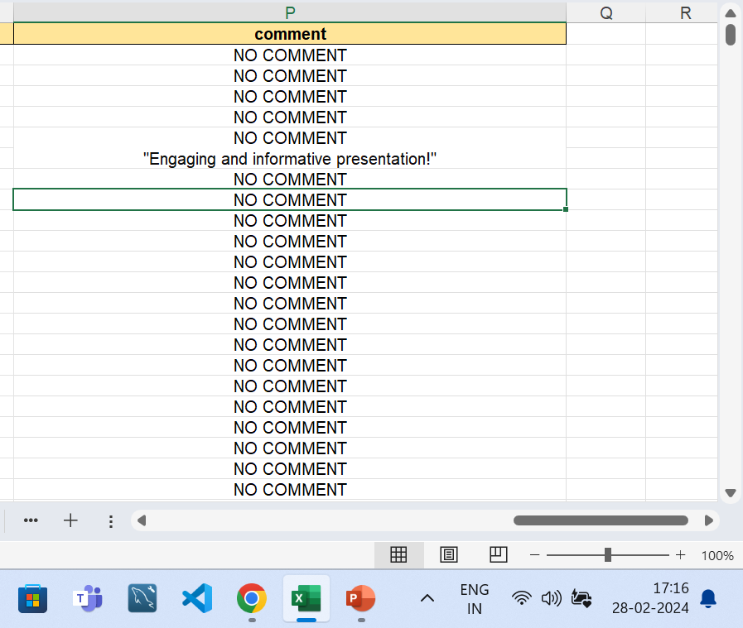
Q1. Insights
There where Blank spaces in the comment
Col, and all the blanks were filled with
“NO COMMENT”
The dates were in changed into “dd-mm-yyyy

Slide 3

Q2. Insights
Average difference btw dates are 2.298
Difference is calculated btw publish date and trending date

Slide 4
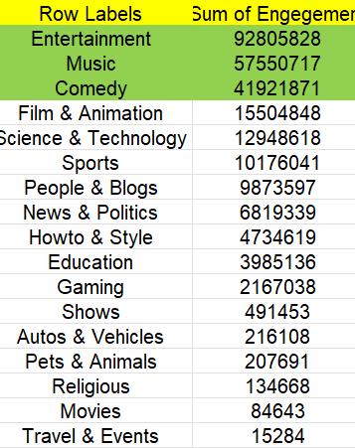
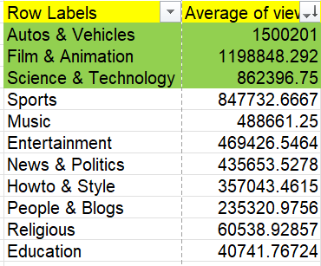
Q3. Insights
These are the channels with high views and engagement

Slide 5
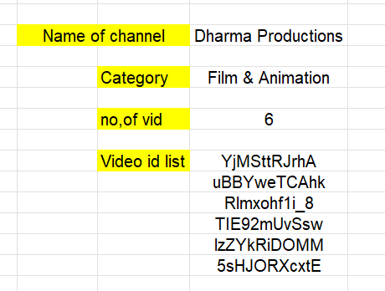
Q4. Insights
Xlookup and filtering is done for “DHARMA PRODUCTION”
Formula= FILTER('YouTube data'!A:A,'YouTube data'!D:D='Q4'!$G$3)
XLOOKUP(XLOOKUP(G3,'YouTube data'!D:D,'YouTube data'!E:E,"NODATA"),Category!A2:A33,Category!B2:B33,"NODATA")

Slide 6
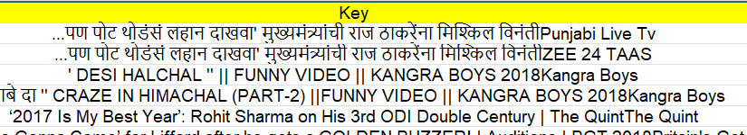
Q5. Insights
Key was done using CONCAT
There was no change in TEXTJOIN for comments

Slide 7
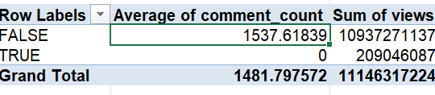
Q6. Insights
Difference between disabled and enabled

Slide 8
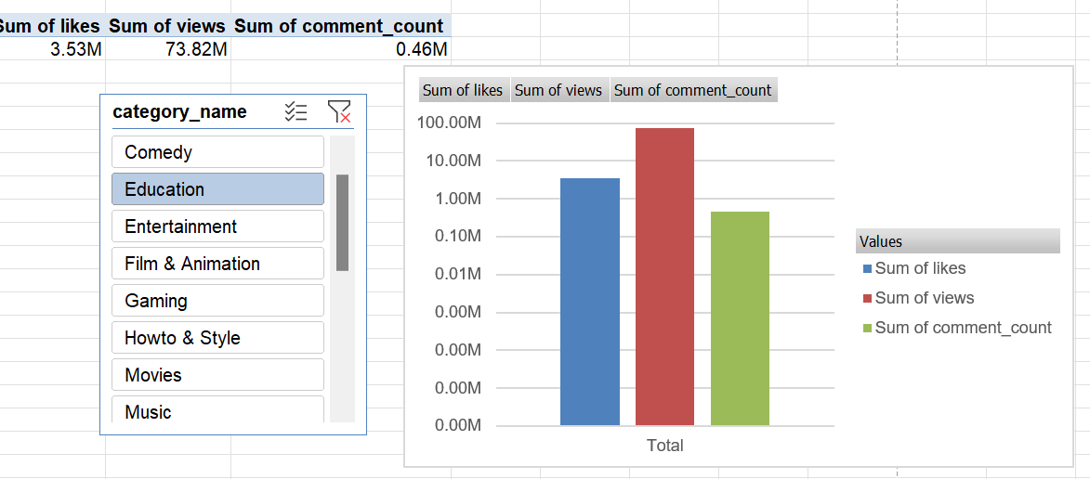
Q7. Insights

Slide 9
Q8. Insights

Slide 10
Q9. Insights

Slide 11
Q10. Insights

